Slide 1
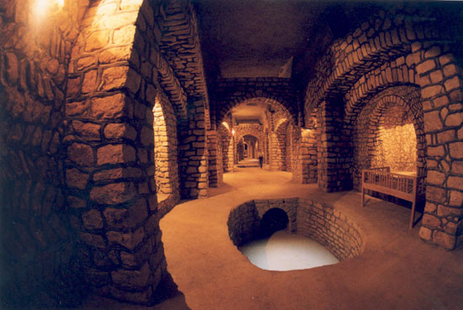
Qanat
Notes:
A large portion of the ancient Iran was located in the dry and hot region which was confronted to the shortage of the water supply. Thus the ancient Iranian engineers started to invent a water supply named Qanat which were very substantial in maintaining the population of the human settlement and providing irrigation in those areas.
What was Qanat?
“Qant was a series of vertical shafts, which were connected by gently sloping tunnels”. This technology was invented and developed by Persian in the early 1st millennium BC and then spread to the other parts of the world from east to the west.
http://en.wikipedia.org/wiki/Qanat

Slide 2
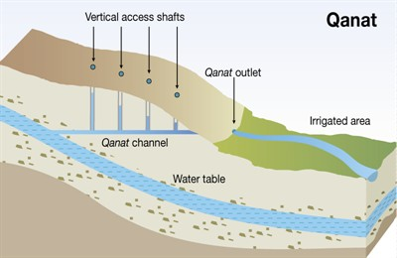
Notes:
Qanat was a series of underground wells which were connected together. They created an underground water channel for delivering the water from the water table to the areas which were far away from those water sources. It had a mother well and contains some other vertical access shafts which provided access to the water table for irrigating the irrigated areas, the greet part of the image.

Slide 3
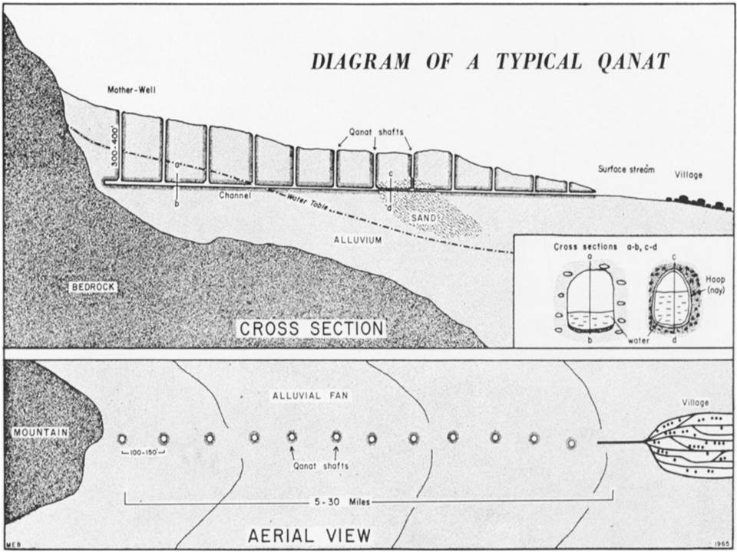
Notes:
This image shows again a typical diagram of a Qanat. As you see the mother well was about 300 to 400 m.

Slide 4
Notes:
Here I have a clip of how Qanat was invented by Persian.

Slide 5
Qanat or Kariz
Water supplement system
Underground aqueduct
Man-made water channels
Far away from city
Transferring water
Sinking a series of wells and linking them underground
Notes:
Thus a Qanat was a water supplement system and an underground aqueduct which was man-made water channels.
They were far away from city and were built to transferring water to the human settlements. It worked by sinking a series of wells and linking them underground.
(1)Sanizadeh, S. K. (2008). Novel hydraulic structures and water management in Iran: a historical perspective. Water Culture and Water Conflict in the Mediterranean Area, CIHEAM-IAMB (Bari), 25-43.
(2) http://www.destinationiran.com/water-management-in-ancient-persia.htm
Novel hydraulic structures and
water management in Iran:
A historical perspective
Shahram Khora Sanizadeh
Department of Water Resources Research, Water Research Institute, Iran , ran
Summary. Iran is located in an arid, semi-arid region. Due to the unfavorable distribution of surface water, to
fulill water demands and luctuation of yearly seasonal streams, Iranian people have tried to provide a better
condition for utilization of water as a vital matter. This paper intends to acquaint the readers with some of the
famous Iranian historical water monuments.
Keywords. Historic – Water – Monuments – Iran – Qanat – Ab anbar – Dam.
Structures hydrauliques et gestion de l’eau en Iran : une perspective historique
Résumé. L’Iran est situé dans une région aride, semi-aride. La répartition défavorable des eaux de surface a
conduit la population iranienne à créer de meilleures conditions d’utilisation d’une ressource aussi vitale que
l’eau pour faire face à la demande et aux luctuations des débits saisonniers annuels. Ce travail vise à faire
connaître certains des monuments hydrauliques historiques parmi les plus fameux de l’Iran.
Mots-clés. Historique – Eau – Monuments – Iran – Qanat – Ab anbar – Barrage.
I - Introduction
Iran is located in an arid, semi-arid region. Due to the unfavorable distribution of surface water,
to fulill water demands and luctuation of yearly seasonal streams, Iranian people have tried to
provide a better condition for utilization of water as a vital matter.
Iran is located in the south of Asia between 44º 02´ and 63º 20´ eastern longitude and 25º 03´ to
39º 46´ northern latitude. The country covers an area of about 1.648 million km2
.
Iran is bordered on the north by Armenia, Azerbaijan, Caspian Sea and Turkmenistan; on the east
by Afghanistan and Pakistan; on the south by Oman Sea, Strait of Hormuz and Persian Gulf; and
on the west by Iraq and Turkey (Fig. 1).
Climatologically, Iran is situated in the arid and semi-arid regions of the world. Of the total area,
13% has a cold and mountainous weather, 14% has a moderate climate and the remaining 73%
is covered by dry weather.26 Options Méditerranéennes A 83
D
R
Figure 1. Map of Iran.
D
R
Figure 2. A water bearer in old Tehran.
Water balance of the country according to 30 years of data shows that the average annual
precipitation is 250 mm. 30% of the precipitation occurs in the form of snow and the rest in the
form of rain.
Principal uses are categorized in different sectors in the country. Although uses in the agriculture
sector is much more dominant in comparison with the other (i.e. Industrial and urban and rural),
it has had much less growth.
From the point of view of the number of dams under construction in the country, Iran is among
the irst countries in the world. A great deal of emphasizes has been placed on the surface runoff
control and optimized utilization of these resources and their high potential.Water Culture and Water Conlict in the Mediterranean Area 27
At present the Ministry of Energy of I.R. Iran, realizing the importance of control and optimum
utilization of water. The speciications of the water supply services are: more than 130 reservoir
dams with regulating capacity of 34 billion cubic meters, major irrigation and drainage networks
in 1.5 million hectares, minor irrigation and drainage networks in 0.7 million hectares, hydropower
plants with a capacity of 11000 megawatts and inally 110,000 deep wells and 300,000 semi-deep
wells with total capacity of 44 billion cubic meters.
The archaeological survey’s indings indicate that human being lived in various part of Iran as
long as 15,000 years ago. Persia was a Cradle of Science in earlier times. The civilization in
the western part of the Iranian plateau lourished 5000 years ago and they invented cuneiform
writing. Discoveries prove that Iranians were peaceful and ingenious people in the second and
third millennium BC who cultivated land and raised crops.
The irst Iranian lived in meadows to feed their livestock. Some of them became familiar with
techniques of irrigation and chose to be farmers. The importance of irrigation is pronounced in
Iranian ceremonies, traditions and religious beliefs. Water has been depicted in many Zoroastrians
and Anahit was believed as the Goddess of water. Lack of water in Iran affected the Iranian history
and culture.
Dam construction in Iran dates back to the ancient times. Iranians are credited for invention
subterranean canals (Qanats) which is well-known in the world.
II - Qanat (Kareez)
Qanat or kareez is a technical method used to provide a reliable supply of water to human
settlements or for irrigation in hot, arid and semi-arid climates. The origin of this technology dates
back to the ancient Persian Empire (Fig. 3).
The main idea to construct the qanat was to access and transfer of groundwater by sinking a
series of wells and linking them underground.
The construction of qanats by Iranians dates back to 3000 to 4000 years ago. In particular, the
oldest and largest known qanat is located in the Iranian city of Gonabad which after 2700 years
still provides drinking and agricultural water. Its main well depth is more than 360 meters and its
length is 45 kilometers. Yazd and Kerman are also known zones for their dependence with an
extensive system of qanats (Fig. 4).
Vertical Access Shafts
Quanat Outlet
Irrigated Area
D
R
Figure 3. Qanat Construction.
Persia is currently beneiting from 31000 active qanats producing some 9 billion cubic meters of
the groundwater and forming some 15% of the aquifer discharge which is annually mined across
the country. This huge amount of water is amazingly conveyed just by means of gravity. Since
no electric or fossil energy is employed, this system is pollution free and bears no environmental
contaminants.28 Options Méditerranéennes A 83
Qanat technology is not only an Iranian system of water mining, but also has overshadowed
our economic, social and cultural outlooks since three thousand years ago. However due to the
development of tube wells some of the qanats are going dry. Even then there are 50,000 qanats
in Iran and nearly 75 % of them are still working III - Water supply and water treatment system
Transfer and distribution of water in the past was performed using earthenware pipelines. This
system was also used in the Takht-Jamshid Palace just to discharge the sewerage network and it
can be seen that this method was not changed so much during the past 2500 years. (Fig. 5)
The oldest physical water treatment system in the world named in Chogha Zanbil (Fig. 6) was
built approximately 3000 years ago that located next to the Ziggurat of Chogha Zanbil in city of
Susa.
D
R
Figure 5. The general layout of the open air water ways in the Takht-Jamshid palace.
Water was transferred from Karkheh River (on the west of Susa) to a sedimentation basin and
then the town over a distance of 45 Km via an open canal. The reservoir with dimensions of
70.1m length, 7.25 m wide and 44.35 m depth has a capacity of 350m3. Materials such as tar and Water Culture and Water Conlict in the Mediterranean Area 29
brick were used for building the structure. Once the reservoir was illed to maximum level, the
physically treated and de-silted water lowed in to the basin (located at a higher elevation) via the
nine mentioned conduits.
D
R
Figure 6. Physical water treatment basin, Chogha Zanbil temple.
IV - Subterranean water reservoirs
1. Ab Anbar, Water Warehouse
Subterranean water reservoirs (Ab Anbars) are historic hydraulic structure of Iran for drinking
water supply that still persists in some regions of Iran. The main purpose of this structure was
supplying water demands of the passing caravans as well as people living close by. Subterranean
water reservoirs were cylindrical in shape with arched ceiling and usually located in arid lands. In
some regions, wind towers are also built for cooling and aerating water. Access to collect water
was by a staircase going deep down to the lowest level of the reservoir. The storage capacities of
these reservoirs vary from 300 to 3000 m3
(Fig. 7 and 8).
The construction material used for Subterranean water reservoirs were very tough and extensively
used a special mortar called Sarooj made of sand, clay, egg whites, lime, goat hair, and ash in
speciic proportions, depending on location and climate of the city.
Figure 7. Amir Chaghmagh Water Reservoir, Yazd.
This mixture was thought to be completely water impenetrable. The walls of the storage were
often 2 meters thick, and special bricks had to be used.
These bricks were especially baked for water reservoirs (Ab Anbars) and were called Ajor Ab
Anbari. Some water reservoirs (Ab Anbars) were so big that they would be built underneath
caravanserais such as the water reservoir (Ab Anbar) of Haj Agha Ali in Kerman. Sometimes
they would also be built under mosques, such as the water reservoir (Ab Anbar) of Vazir near
Isfahan.
V - Dam Building
Iran is located in an arid-semiarid region. Due to the unfavorable distribution of surface water, to
fulill water demands and luctuation of yearly seasonal streams, people have never ceased their
endeavors to provide a better condition for utilization of water as a vital matter.
Dam construction in Iran dates back to the ancient times. Iranians carefully considered the three
basic factors, site selection, and foundation condition and construction materials.
In all cases, they fully observed all design and technical requirement and circumstances in
the dam site and site selection. Topography and river diversion during construction were also
profoundly attended to (Fig. 9).
All Iranian ancient dams are masonry of the following types:
1. Gravity dams
Studies indicate that all the design criteria considered in the recent design of gravity dams were
taken into the consideration in the design of Iranian ancient dams. Saveh and Sheshtaraz dams
which are over 700 and 900 years old respectively are examples of this type.
2. Arch dams
Iranians perceived the high bearing of arches before Romans. Kebar (one of the oldest arch dams
in the world has a height of 26m, a crest length of 55m and a thickness of 5m with an arch radius
of 38m which proves the skills of Iranians in dam construction) and Kerrit dams (Fig. 10) over 700
and 400 years old respectively are both arch dams.
3. Buttress dams
Akhlemad dam (Fig. 11) with a crest length of 230m, height of 12 m and reservoir capacity of 3
milion cubic meters and Fariman dam, 400 years old, are both buttress dams. Both dams are still
under operation.
Water Culture and Water Conlict in the Mediterranean Area 33
D
R
Figure 10. Kerrit Dam.
3. Buttress dams
Akhlemad dam (Fig. 11) with a crest length of 230m, height of 12 m and reservoir capacity of 3
milion cubic meters and Fariman dam, 400 years old, are both buttress dams. Both dams are still
under operation.
D
R
Figure 11. Akhlemad Dam.34 Options Méditerranéennes A 83
Saveh arch dam and Durudzan ill dam are 2 modem structures that have been built very close to
the old dam sites. The largest dam by height in Iran is Karun 3 (Fig. 12), and the largest dam in
Iran by reservoir capacity is the Karkheh dam (Fig. 13) which is located in Khouzestan province.
A quick glimpse at what is the remains of the past, reveals ingenuity of ancient Persians in water
engineering and hydraulic works. Arch dams built from excellent materials, some of them 1000
years old, are still functioning here and there, each being a genuine masterpiece.
Modern dam construction industry, especially construction of large dams began 3 decades
ago. Investigation and design of large storage dams commenced in 1948 in the framework of
mid-range development plans and the dam construction actually began late 1950 s (Fig. 14).
Controlling surface water has been a major issue in the development plans. At present there are
171 Large dams under construction, 85 large dam under operation and 1668*103
ha construction
of main irrigation and drainage networks and Iranian engineers are involved in the study, design,
construction, supervision, operation and management of them
VI. Yakh-Chál (Ice-chamber)
A Yakh-chダl (Ice-Chamber) is an ancient natural refrigerator which was mainly built and used in
Iran to store ice, but sometimes was used to store food as well. In summer season, people living in
nearby villages used to supply their ice demands from these structures. The subterranean space
coupled with the thick heat-resistant construction material kept the outside heat from reaching the
interior space year round (Fig. 15). This ice was from the ancient times used for the making of
Faloudeh (the traditional Persian ice cream).
In 400 BC Iran, Iranians had mastered the technique of storing ice in the middle of summer in the
desert. Yakh-chダl was a large underground space (up to 5000 m³) that had thick walls (at least
two meters at the base) made out of a special mortar called Sarooj, composed of sand, clay, egg
whites, lime, goat hair, and ash in speciic proportions, and which was resistant to heat transfer.
This mixture was thought to be completely water impenetrable. The space often had access to a
qanat, and often contained a system of wind catchers that could easily bring temperatures inside
the space down to frigid levels in summer (Fig. 16).
The method of ice production is interesting. In the winter seasons, a certain amount of water used
to be stored within the thick and high walls of designated chambers, the bottom surfaces of which
were already lattened. The winter cold during the night times was suficient to produce each
night, ice a few centimeters thick. The high walls of the chambers which were constructed in the
east-west directions protected the ice, facing north, against the sun rays. This method needed a
skilled approach in judging the rate of ice production at each stage. Once the thickness of the ice
had reached 30 to 40 cm, it was broken into pieces and then stored in the circular ice-chambers.
A few wells were excavated in the bottoms of the ice-chambers to collect the ice melt during the
hot seasons. The surfaces of the layer of ice used to be covered with straw to keep one layer
separated from the adjacent ones. The ice-chamber also had two corridors: one was used for
storing ice blocks in the winter and the other, for taking them out in the summer. Ice-chambers
were active in the winter times to store ice and in the summer times to consume it.
The Meybod ice-chamber (Fig.17) is the oldest remaining one that is located 50 km north of Yazd
city, next to an ancient caravan road. This building has remained intact and it is considered as a
perfect example of the architectural style in its own type.
VII - Water mills
One of the skills of ancient Iranians was to make use of the water’s hidden power to rotate the
stones of the watermills. The roof of a watermill building was usually a dome. Light and air were
supplied through a door.
The watermills were powered by the river currents, springs or qanats. Water mills were connected
to the water sources by canals’. A conduit just before the mill shaft would act as a bypass when
the mill was not in operation. The mill shaft is semi conical in shape and its diameter reduces
from top to bottom. This shaft can be plugged by a wooden device which is accessible through a
narrow gallery from inside the mill.
The wooden turbine consists of a wooden axle, the diameter of which increases gradually from
top to bottom. It has a lower iron tip housed in a pit in the lower millstone, acting as the turbine
support. The upper iron tip of the axle is ixed in the upper millstone. This axle is surrounded by
some paddles and the whole system is known as the turbine wheel. When a water jet impinges
forcefully on the turbine wheel, it rotates, and this in turn causes the upper millstone to be turned.
The lower millstone is stationary and the rotation of the upper stone on the lower grinds the
grain. There is a hole in the middle of the upper stone, which discharges the grain into the space
between the two stones. The two millstones are not truly horizontal, but are slightly inclined which
helps the lour to be discharged into the lour bags (Fig.18)
The grains are stored in a silo located at the top of the watermill and are discharged through a
wooden hopper into the hole dugout in the upper stone. By the rotation of the upper stone and the
continuous strokes on the hopper, the grains in the silo discharge down. The water is guided out
through a conduit built below the watermill (Fig.19 and 20)
Some parts of the roofed mill compound are designated for the cleaning and screening of the
grains and lour production. A space is also foreseen to lodge the animals, which are used to
transport the lour bags.
The Gar-Gar and Amir Weir mills were powered by the reservoir water. Kashan town’s Fin’-garden
watermill was rotated by a spring, whereas Double Stone Water Mill of “Mohammad Abbad –
Meybod” (Fig. 21 and 22), ancient watermill of Ashkezar, 15 km away from Yazd, and the two
hundred year old Taft watermill were all, powered by the neighboring qanats
Double Stone Water Mill of “Mohammad Abbad – Meybod is an amazing hydraulic structure is
absolutely unique. It has been created at the depth of 40 meters on qanat gallery in order to grind
grains into lour (Fig. 21 and 22).
The neighbouring oases supplied their consuming lour from this 150 year old water driven
structure. No construction materials had been used to establish this marvelous mill.
The vestibule of the mill is so high that even camels could move back and forth easily and the
lateral stables would room cows, donkeys or camels to carry lour. The mill is remotely situated in
a deserted area some 8 km. out of “Mohammad Abbad” village which is 50 km. from Yazd.
Dust and slime had illed the mill’s long narrow passage gradually in the course of time due to
lood waters which was unblocked by the regional water authorities who made a lot of endeavors
to excavate it. This mill is open to visitors’ at present.
VIII - Speciic examples
1. Khaju Bridge
Khaju Bridge (Fig. 23) is one of the most famous bridges in Isfahan, Iran and has roused the
admiration of travelers since the 17th century. Shah Abbas II built it on the foundations of an older
bridge around 1650 AD. It has 23 arches and is 105 metres long and 14 metres wide. This bridge
is used to connect the town’s old square and roofed bazaar to the new part. The pass way of
the bridge is 7.5 meters wide, made of bricks and stones with 21 larger and 26 smaller inlet and
outlet channels. The pieces of stone used in this bridge are over 2 meters long and the distance
between every channel and the ceiling base is 20 meters. The existing inscriptions suggest that
the bridge was repaired in 1873.
The Khaju Bridge is also a weir (the downstream side is formed as a series of steps carrying the
water to a much lower level) and consists of a gallery, which being next to river water was a cool
and ideal place to spend the time during hot times of the day. The lower level of the bridge may be accessed by pedestrians and remains a popular shady place for relaxing.
Khaju Bridge is a good Iranian water engineering symbol because of employment of integrated
urban management system and methods of hydraulic engineer and Iranian architecture
together.
2. Measurement in Ancient Iran
Due to the large extent of the country and the variety of the existing water resources, different
methods for water low measurement were developed in various regions, The smaller the volume
of water, the more accurate was the measuring method. The “water distribution measurement
device” consisted of a lat copper tub, a perforated cup and the stone (an old measuring scale).
Wherever there was an abundance of water and no conlict between the farmers, these devices
known as water distributors were used on the river junctions to measure and calibrate the low.
One of ancient Iranian scientist, Sheikhbahayee, designed the best way to measure distribution
of the volume of water from Zayandehrour river for agriculture. This method called the
Sheikhbahayee’s roll (Toumar-e Sheikh Bahayee) was used for ending the conlicts between
farmers who lived around Zayanderoud river.
Also Amrikabir, prime minister in Qajarieh period, transferred water from Karaj river (a city located
near Tehran) to Tehran (capital of Iran) and established a roll to distribute water of Karaj river
between farmers (Fig. 24)
1. The Shooshtar water mills
This weir-bridge located in the city of Shooshtar, located 400 meters downstream of e-Mizan weir and upon the Gar Gar River is a weir-bridge which was built with the purpose of retaining water at a speciic elevation. Three main canals and several ancillary canals have been excavated in the sandstone foundation of this structure in order to supply the water required to run at least 32 water mills. Currently the water once used for the running of the water mills lows unhindered in the form of striking waterfalls (Fig. 25).
X - The Oldest River Retaining Wall in the World
The oldest river retaining wall in the world is to be found downstream of the Karkheh dam and was
built during the Sassanians period (Fig. 26).
This wall was built with the purpose of minimizing the erosion of the river bank and preventing
the unforeseen diversion of river low. It is built of hand hewn stone, brick and Sarooj. This wall is
110 meters in length, 2.5 meters wide and 5 meters high forming a sloping trapezoid alongside
the Karkheh River. Modern retaining walls along the Karkheh River are made by joining cement
blocks (gabions)
XI - Conclusion
This paper intends to acquaint the readers with some of the famous Iranian historical water
monuments. Observing the introduced structures reveals the deep insight of engineering sciences
and making eficient employment of available regional materials in ancient time. Qanats, water
mills and old dams have been utilized for centuries and compatible with the modern progresses
of the engineering sciences. Yakh-chダl (Ice-Chamber) does not have any application today but
architectures can utilize some architectural principles and methods of exploitation for designing
modern structures. Subterranean water reservoirs (Ab Anbars) can still be use in deserts and
arid regions for supplying water demands. Due to the unfavorable distribution of surface water, to
fulill water demands and luctuation of yearly seasonal streams, people have never ceased their
endeavors to provide a better condition for utilization of water as a vital matter. Dam building is a
symbol of the widespread engineering methods, precision and accuracy of the past generations
that their knowledge and experiences disclose to their modern age descendants. I hope that this
paper can be a step forward to inform readers with a shortage review of water situation and some
of the reputed historic hydraulic structures across the country of Iran.

Slide 6

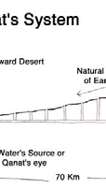
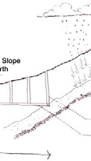
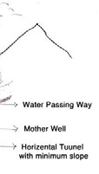
Qanat
Notes:
This image again shows how it worked:
There was a mother well which was about 100 m underground. It worked by using the natural slop of the earth.
Thousands of water wells were connected together by Qanat. The length of the water channel in this image is 70 KM. The water source was fill with the rain and then the mother well which other wells were connected to it had access to this water table. The water shafts were connected together with a horizontal tunnel with a minimum slope.
(1)Maleki, B. A. Traditional Sustainable Solutions in Iranian Desert Architecture to Solve the Energy Problem. International Journal on Technical and Physical Problems of Engineering (IJTPE), (6), 84-91.
(2) Sanizadeh, S. K. (2008). Novel hydraulic structures and water management in Iran: a historical perspective. Water Culture and Water Conflict in the Mediterranean Area, CIHEAM-IAMB (Bari), 25-43.

Slide 7
What was the reason for digging the vertical shaft?
  The vertical shaft were dug at the intervals of 20 to 30 meters. This way the excavated material were removed and the system were accessible for repair. Also this provided ventilation access for the repair.
  The first vertical shaft started from a sandy area far from the village and ended to the village.
  This stream of vertical shafts slopped down gently. In this way water was distributed to different area for irrigation or other purposes.

Slide 8
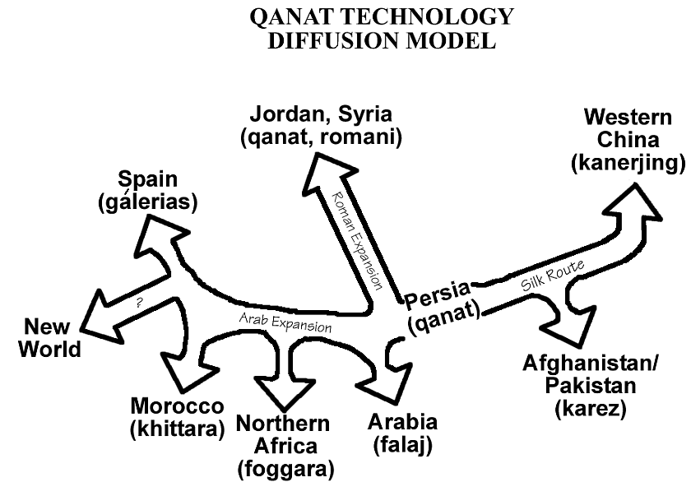
It is interesting that some Qanat system are stretching from China to Morocco and even to America!
Notes:
By expansion of the Persian Empire by 550-331 BC the technology spreaded to the Indus to the Nile.
To the East Qanat was constructed along the silk road to China
http://www.waterhistory.org/histories/qanats/

Slide 9
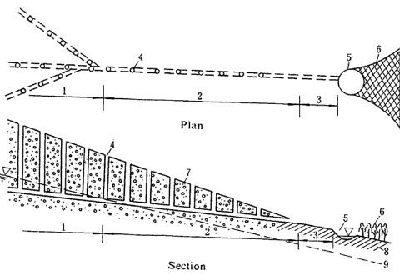
(1)Infiltration part of the tunnel
(2) Water conveyance part of the tunnel
(3) Open channel
(4) Vertical shafts
(5) Small storage pond
(6) Irrigation area
(7) Sand and gravel
(8) Layers of soil
(9) Groundwater surface

Slide 10
Advantages of the Qanat System:
  Since the water channel is underground it prevented the seepage and evaporation
  There was no need for pumping the water since the system worked with gravity
  A renewable source of the underground water was utilized

Slide 11
A renewable sour of the underground water means that Qanat didn’t/ doesn’t cause the lowering of the ground water level since its water flow rate is controlled by the ground water table’s level and its water flow related to the level of the subsurface water source.
Therefore it was/is a sustainable system

Slide 12
The main usage of the Qanat was for irrigation during the day lights and the growing seasons (Spring and Summer).
During the winter and Fall since the water usage was low, the water was preserve for the purpose ofhigh usage in the summer and spring

Slide 13
Construction
A windlass was set up to bring the excavated soil to the surface
Dumping the excavated soil around the opening of the vertical shaft
  This feature prevent the surface overflow which contained deposit and mud to enter the shaft
A one meter diameter vertical shaft dug out
A gently slopping tunnel to carry the water to from ground water wells to the surface

Slide 14
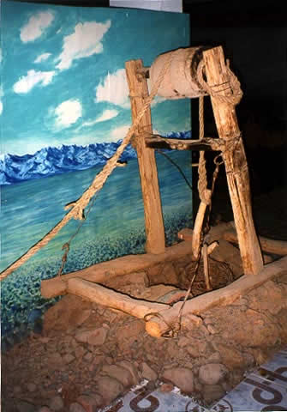
Notes:
As you see in the image a windlass was set up to bring the soil to the surface

Slide 15
In the firm soils there was no need to lining
“In the loose soil reinforcing rings made of burnt clay were installed at intervals to prevent cave-ins”
The channel bed needed periodic cleaning to prevent build up of the deposits such as mineral and salts

Slide 16
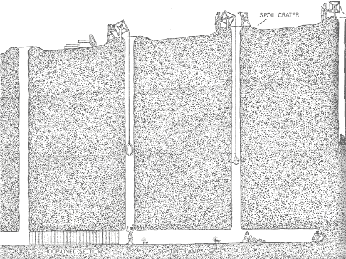
Notes:
This image shows the construction of the Qanat by using reinforcing rings(?)

Slide 17
The Urban Lay Out Of Qanats
In some cities the qanat channel goes beneath the residential areas.
The water will come to surface near the area of the cultivation
Staircase provided access to the water
There were some public reservoirs which were for public usages
Some of these reservoirs had 15 meters depth with spiral stair which ended to the small platform of water

Slide 18
In addition to the public usages, Qanat water used for household usages as well.
In some wealthy houses a special room were built besides the channels along with a vertical shaft which went upward to a wind catcher to provide cooling

Slide 19
Construction of a Qanat not only needed technical expertise, but also needed water management regulations and also
It required the cooperation of the users and their willingness to contribute in the managing the water distribution and also cleaning the water channel
Also it brought social cohesion to the local people using this system
Notes:
http://www.waterhistory.org/histories/qanats/

Slide 20
Nowadays System of Qanat
22,000 Qanat in Iran exist
The underground conduit of 170,000 miles(built with manual labor)
The system delivers a total of 19,500 cubic feet of water per second which is equal to 75 % of the discharge of the Euphrates River into the Mesopotamian plain
This amount is sufficient for irrigating of 3,000,000 agricultural land
Notes:
This way by Qanat desert became garden!
http://www.waterhistory.org/histories/qanats/

Slide 21
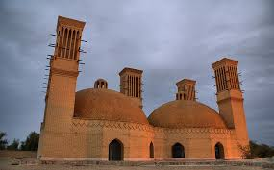
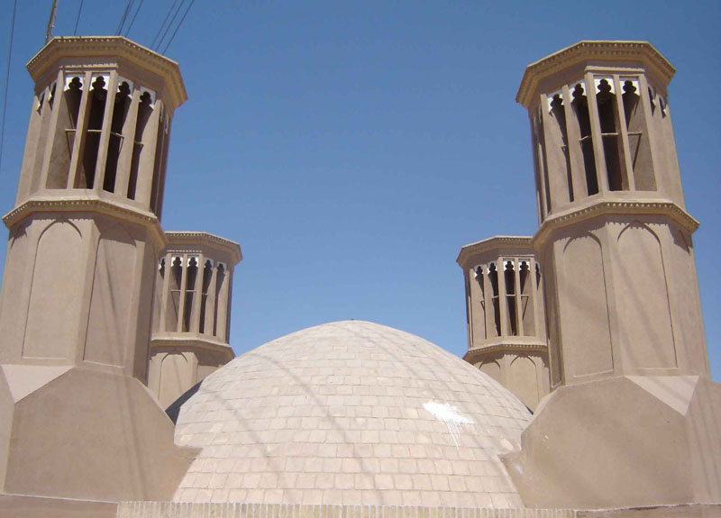
AB ANBAR OR WATER RESERVIOR
Notes:
The other structure which was invented with ancient Persian and I am going to introduce it today to you was Aba Anbar or water reservoir.
Ab Anbar was a traditional drinking water reservoir invented by ancient Persian.
How was the structure of an Ab Anbar?
Ab Anbar had a water storage tank which were built under the ground. The plan of the underground space was rectangular or circular with a dome capped the tank above the ground level. The combination of the underground space and a dome caused the structure to be resistant to the earthquake. The structure of the rectangular space with a dome was much more harder than the cylindrical one, but covering the cylindrical space was easier and also it was more hygienic for the water supply due to the absence of any corner.
These two images show the structure of an Ab Anbar from outside.
As you see in the image Ab Anbar structure was along or combined with a wind catcher. Wind catcher helped the water supply became cool. Wind catcher created pressure gradient which helped the hot air to rise while the cold weather stayed. The heat resistant material also cause the inside of the water reservoir become cool like the inside of a cave.

Slide 22
STRUCTURE OF A WIND CATCHER
Dome
Rectangular or Cylindrical space
Wind Catcher
Opening or Sar Dar
Staircase
Platform
Notes:
In general the structure of a water reservoir was constructed of a dome which covered a rectangular or cylindrical space. It also had one or two or more wind catchers. It had two openings or Sar Dar. It had two staircases with platforms for ascending or descending from the stair cases for pedestrians to take rest. I will explain this structure more in detail in the next slides.

Slide 23
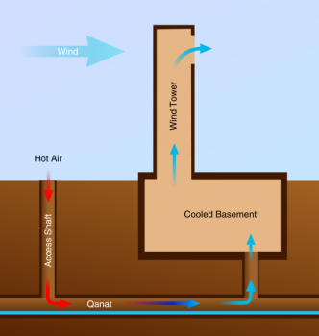
Qantas in Combination with Wind Catcher
Notes:
Qantas & wind catcher also works together. In this kind of design, the open side of the tower faces away from the wind and the directional ports also were designed at the top. All of these ports were closed and the one facing away from the wind was open. As the result because of the Coanda effect the air was drawn upward.
“By closing all but the one facing away from the incoming wind, air is drawn upwards using the Coandă effect, similar to how opening the one facing towards the wind would pull air down into the shaft”.
“The Coandă effect /ˈkwɑːndə/ is the tendency of a fluid jet to be attracted to a nearby surface”
Since there is a pressure difference on one side of the building thus the hot air was draw down into the other side o the building. This hot air contacted both the cold earth since it was several meters underground, and also the cool water. Then this hot water got cool and again due to the Coando effects it transferred and went up, inside the building and had its cooling effects.
http://www.solaripedia.com/13/205/2092/wind_tower_qanat_illustration.html
http://en.wikipedia.org/wiki/Coand%C4%83_effect

Slide 24
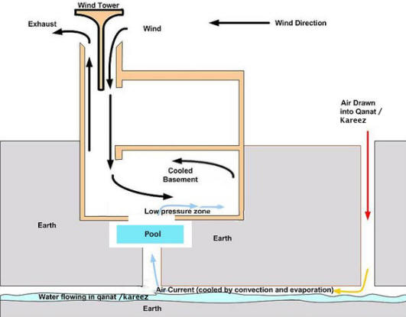
Qantas in Combination with Wind Catcher
Notes:
Windcatchers come in various designs, such as the uni-directional, bi-directional, and multi-directional.
However In this image the two sides of the tower are open ( I am not sure whets the difference of the tow kind of design? ) You see the pool in this image. It did fasten the cooling time perhaps, instead of using directly form underground water.
http://cooling-towers.blogspot.com/2011/11/windcatcher-and-qanat-used-for-cooling.html

Slide 25
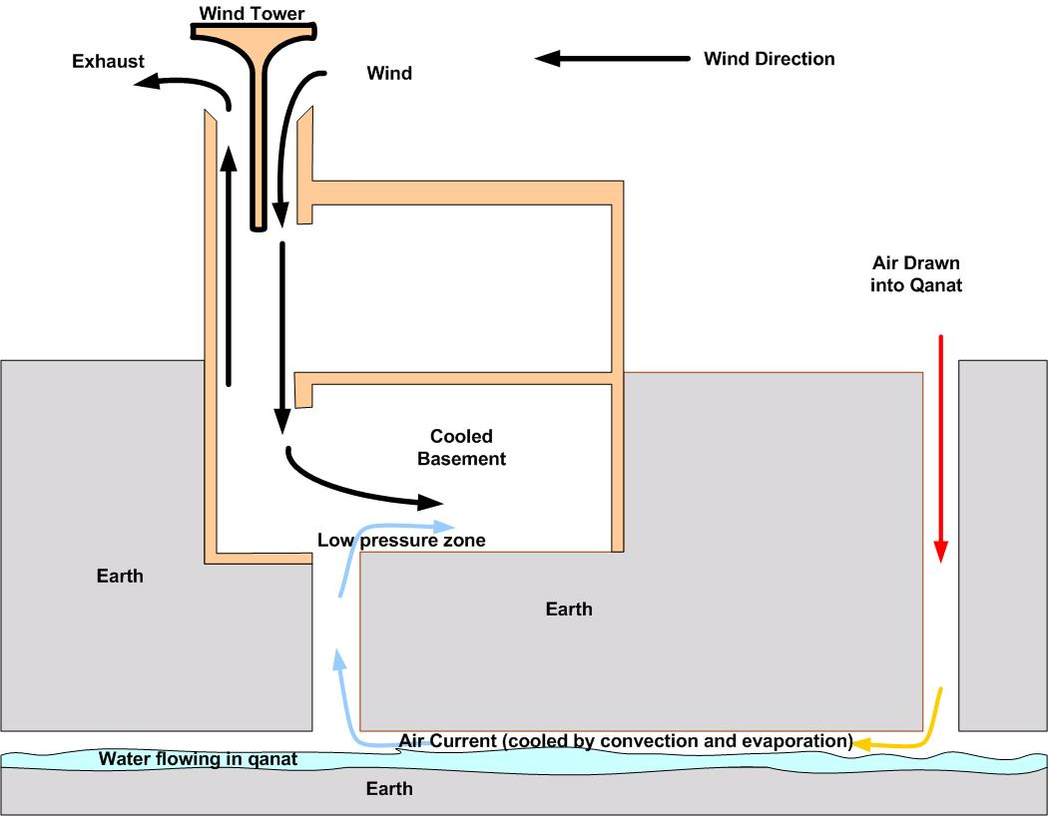
Notes:
There were different kind of the design and it did depend to the situation. As you see in this image the tower was design without having the pool but using directly form the underground water Qanat.

Slide 26
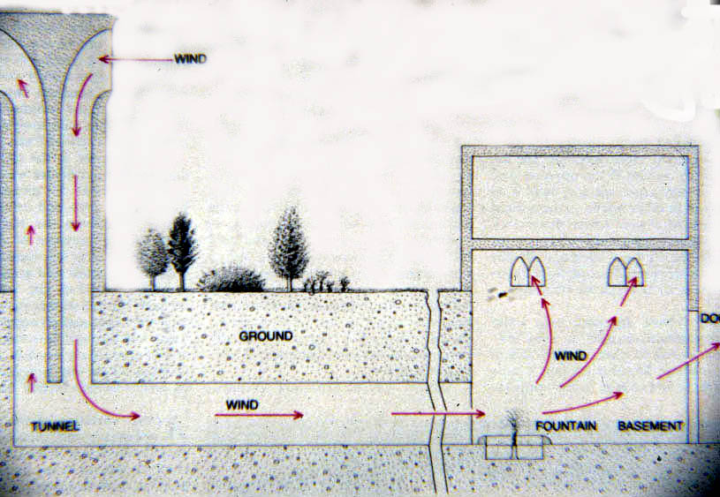

Slide 27
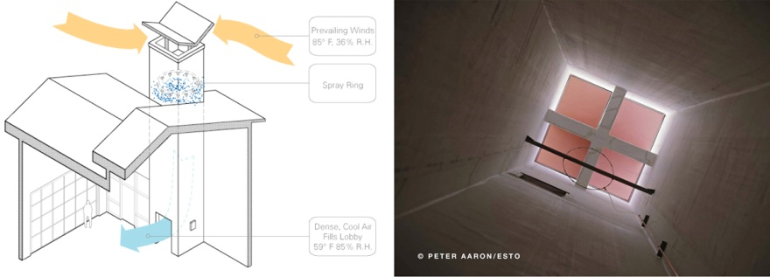
Modern wind catcehr
Notes:
Moidern wind cathcehr

Slide 28
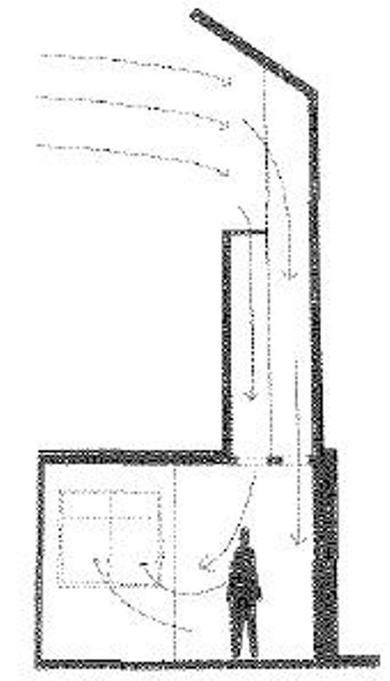

Slide 29
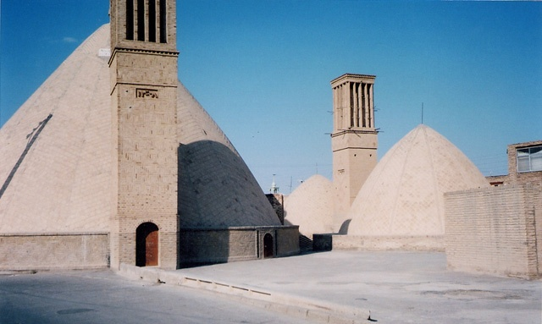
Water Reservoir or Ab Anbar
Implementing wind catcher
Air blow from one side, out form the
other
Exposure to fresh air
Openings for light
Notes:
And again what was the advantages of the wind catcher for the ab anbar? Wind catcher exposed the ab anbar to the fresh air. And also they were openings for the light.
http://www.destinationiran.com/water-management-in-ancient-persia.htm

Slide 30
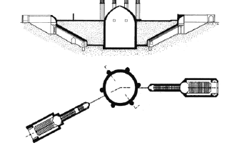
ACCESSS TO THE AB ANBAR
Notes:
Here you see the plan and the section of an ab anbar.
To have access to the water supply, there were two openings with two staircases which led to the water faucets. You see these opening at the right and the left sides of each image. At the beginning and the end of the staircases there were platforms built for pedestrians to take rest after ascending or after descending.
As you see these dome ceiling ab anbar has 4 wind catchers. The openings of the water reservoir are at the left and right side if the image. Each opening are connected via a staircase to the water storage. I contains some platforms on the way of the staircases. The inside space in this ab anbar is cylindrical. Sardars were decorated and also had the date of the construction wrote on them.

Slide 31
Water Reservoir or Ab Anbar(Con.)
Two openings
- Inlet & outlet
- Slightly elevation difference
- Filled from one side
left form the other side
Constant flow of water
Always fresh
Storage capacities varied from 300 to 3000 m3 (1), (2)
Notes:
Also the water tank had two opening as well which had slightly elevation difference. The water tank was filed form one side and then the water was left form the other side. Thus there was a constant flow of the water always.
(1)http://www.destinationiran.com/water-management-in-ancient-persia.htm
(2) Sanizadeh, S. K. (2008). Novel hydraulic structures and water management in Iran: a historical perspective. Water Culture and Water Conflict in the Mediterranean Area, CIHEAM-IAMB (Bari), 25-43.

Slide 32
Material O the Water Reservoir or Ab Anbar
Material: Traditional cement, Saruj
Sarooj
- clay, egg whites
lime, goat hair, and ash in specific proportions,
depending on location and climate of the city
Walls of the storage 2 meters thickness
- Special bricks used
- Called Ajor Ab Anbari
- Insulated
- Water impenetrable
Notes:
What was the material of the ab anbar?
(1)http://www.destinationiran.com/water-management-in-ancient-persia.htm
(2) Sanizadeh, S. K. (2008). Novel hydraulic structures and water management in Iran: a historical perspective. Water Culture and Water Conflict in the Mediterranean Area, CIHEAM-IAMB (Bari), 25-43.

Slide 33
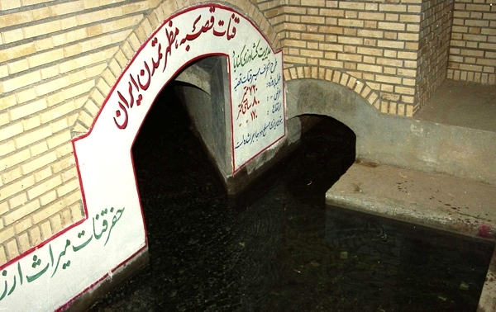
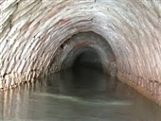
چهارشنبه 7 خرداد Hamshahry 1393
Notes:
افسانه‌ای که عظیم‌ترین شاهکار آبی جهان را طلسم کرد
فرهنگ و تاریخ > میراث‌ ایران- همشهری آنلاین:
قنات قصبه میراث‌دار تمدن ۲ هزار و ۵۰۰ ساله است و قدمت آن به ورود آریایی‌ها باز می‌گردد؛ این اثر تاریخی با معماری کهن یکی از شاهکارهای آبی جهان محسوب شده و دیر یا زود نام جاودانه‌اش در فهرست میراث جهان ماندگار خواهد شد اما بی‌تردید شرط جهانی شدن؛ دفاع همه جانبه و اثبات هویت این اثر از سوی میراث فرهنگی است.
به گزارش مهر، قنات قصبه شهرستان گناباد به عنوان عجایب‌ تاریخ تمدن بشری در زمره عمیق ترین قنات ها قرار دارد و قدمت آن به ورود آریایی ها باز می گردد.امروز این اثر یکی از شاهکارهای آبی جهان است که باید با همت مسئولان میراث فرهنگی هر چه زودتر نام و نسبش در فهرست میراث جهان و بر قله آثار باستانی ارزشمند به یادگار ماند.
عظمتی جاودانه بر دفتر تاریخ خطه خورشید نقش می بندد
قصبه با طول تقریبی33 کیلومتر در جنوب استان خراسان رضوی، اوج هنرنمایی اهالی این سرزمین را به رخ جهانیان می کشاند و چهره این میراث و تمدن آریایی؛ عظمت و شکوهی جاودانه را بر دفتر تاریخ خطه خورشید نقش می زند.
امروز برای حفظ نام و نسب قصبه اقداماتی نظیر ساخت مستند در دستور کار مسئولان بوده و قرار است بزرگترین شاهکار آبی جهان در قاب مستند به تصویر کشیده شود تا سیمای این اثر تاریخی با ارسال فیلمی به یونسکو اثبات گردد.
مستند قصبه به عنوان پیوست به یونسکو ارسال می شود
در حقیقت این مستند به عنوان پیوست پرونده قصبه به یونسکو ارسال می شود تا با نمایش و تصویر کشیدن این فیلم ویژگی‌های منحصر به فرد شاهکار آبی جهان و اهمیت آن به نمایش گذاشته شود.
کارگردان مستند قنات قصبه گناباد در این رابطه به خبرنگار مهر گفت: مستند قنات قصبه با مشارکت صدا و سیمای خراسان رضوی و میراث فرهنگی با هدف ثبت جهانی این قنات در حال ساخت است.
سعید توکلی فر ادامه داد: در کار ساخت این مستند از اثر مکتوب پاپلی یزدی که در زمینه این قنات به رشته تحریر درآمده به عنوان یکی از منابع اصلی استفاده شده است.
قنات قصبه را "دیوها" ساخته اند
وی ادامه داد: آنچه قنات قصبه گناباد را از سایر قنات ها ممتاز کرده؛ عمق مادر چاه آن به عمق تقریبی 300 متر است و بدون تردید برای ساخت این قنات، اقدامی عظیم و حماسه ای بزرگ رخ داده است.
وی با تاکید بر اینکه قصبه دارای ویژگی های بی نظیری است و به سادگی نمی توان در مورد این ویژگی ها سخن گفت، تصریح کرد: مردم گناباد اعتقاد دارند که قنات قصبه را دیوها ساخته‌اند و این امر نشان می دهد که این قنات آنقدر قدمت و عظمت دارد که در مورد آن افسانه‌ ساخته می شود.
این مستندساز ادامه داد: این قنات نشان می دهد که گذشتگان ما در نواحی کم‌آب و بی‌آب زمینه آبادانی را فراهم کرده اند و در حقیقت با آبی که از این قنات بیرون می‌آمده، تمدنی شکل گرفته است.
قصبه میراث دار یک تمدن است
توکلی فر افزود: قنات در فرهنگ مردمان نواحی کویری نقشی پررنگی داشته و در این راستا قصبه با توجه به ویژگی ها و قدمت 2 هزار و 500 تا 2 هزار و 700 ساله در حقیقت میراث دار یک تمدن است و ضرورت دارد تا با ساخت مستندهای این چنینی به یونسکو اثبات کنیم که این قنات باید جهانی شود.
این مستندساز خراسانی تصریح کرد: اگر این قنات وجود نداشت زندگی در بخش‌های وسیعی از فلات ایران امکان پذیر نبود بنابراین تلاش شد تا در این مستند زوایای پنهان و ویژگی های منحصر به فرد این قنات به نمایش گذاشته شود.
مستند قنات قصبه گناباد مراحل پایانی را طی می کند
معاون میراث فرهنگی، صنایع دستی و گردشگری خراسان رضوی در این زمینه گفت: در حال حاضر مستند قنات قصبه گناباد با همکاری صدا و سیمای استان و میراث فرهنگی مراحل پایانی را طی می کند.
حسین عباس زاده عنوان کرد: اسناد پیوستی پرونده قنات قصبه علاوه بر اسناد مکتوب، گزارش ها و نقشه به صورت تصویری است و این مستند نیز به عنوان پیوست به یونسکو ارسال می شود.
وی ادامه داد: قرار است با به تصویر کشیدن ویژگی‌های خارق العاده و منحصر به فرد این قنات اهمیت آن را برای جهانیان به اثبات برسانیم و امیدواریم هر چه زودتر نام این قنات در فهرست میراث جهانی بدرخشد.
شاهکار آبی جهان از دو رشتهٔ اصلی و شش شاخهٔ فرعی تشکیل شده‌است
به گفته وی ساخت فیلم مستند 20 تا 25 دقیقه ای قنات قصبه در مراحل نهایی قرار دارد و پس از اتمام کار این فیلم به یونسکو ارائه می شود.
معاون میراث فرهنگی، صنایع دستی و گردشگری خراسان رضوی یادآور شد: این قنات از شاهکارهای آبی جهان بوده و از دو رشتهٔ اصلی و شش شاخهٔ فرعی تشکیل شده‌است.
وی تصریح کرد: مادرچاه این قنات در دامنهٔ شمالی سیاه کوه و مظهر کنونی قنات در جنوب محلهٔ معروف به قصبهٔ شهر قرار دارد.
لزوم حفظ محیط قدیمی پیرامون قنات قصبه
عباس زاده با اشاره به حفظ محیط قدیمی پیرامون قنات قصبه تاکید کرد: فضای پیرامون قنات قصبه باید همان شکل قدیمی خود را داشته باشد و آثار قدیمی و باغ ها و کوچه باغ هایی که اطراف آن قرار دارد باید احیا شود چرا که رعایت این موضوع یکی از معیارهایی است که باید در ثبت جهانی مورد توجه قرار گیرد.
فرماندار گناباد نیز تاکید کرد: امروز همه باید دست به دست هم داده و تلاش کنیم تا این نماد تمدن ایرانی با ثبت جهانی به عنوان بزرگ ترین سازه آبی در سطح جهان معرفی و شناسانده شود.
محمد صفایی با اعلام اینکه قصبه، قناتی افسانه ای و جادویی است، اظهار کرد: طول این اثر باستانی بیش از 33 کیلومتر است و عمق مادرچاه اصلی در انتهای رشتهٔ "دولاب نو" با توجه به شیب زمین حدود 300 متر و میزان آبدهی آن بیش از 130 لیتر در ثانیه ‌است.
وی از ثبت ملی قصبه در سال 1379 خبر داد و افزود: این قنات در سال 1379 از سوی سازمان میراث فرهنگی در فهرست آثار ملی ایران به ثبت رسیده و ضرورت دارد تا با جدیت هر چه تمام تر برای ثبت جهانی این اثر تلاش کرد زیرا این قنات جدایی از عظمت و قدمتی که دارد، میراث و هویت ماست.
افسانه هایی که عظیم ترین شاهکار آبی جهان را طلسم کرد
از زمانی که ماجرای ثبت جهانی این اثر آغاز شده، افسانه ها و داستان های بسیاری در رابطه با قنات قصبه به گوش می رسد و اغلب این افسانه ها را اهالی بومی منطقه گناباد ساخته اند.
یکی از عجایب و افسانه هایی که بیش از بیش حکایتگر قدمت قصبه بوده این است که این قنات توسط اجنه و دیوان ساخته شده و هیچ بشری نمی تواند چنین کاری را انجام دهد.
امروز این افسانه ها، عظیم ترین شاهکار آبی جهان را در مرز خرافات و واقعیات طلسم کرده طوری که عده ای با تائید این افسانه ها اعتقاد دارند که قصبه با کمک دیوان ساخته شده است.
عباس مقرنسی پژوهشگر آثار تاریخی در این زمینه به خبرنگار مهر گفت: قنات قصبه گناباد موقعیت منحصر به فردی دارد و امروز داستان ها و حکایت هایی که در زمینه این قنات ورد زبان ها شده تا حدودی واقعیت دارد.
وی ادامه داد: این قنات یکی از پدیده های حیرت انگیز ساخته دست بشر است که از یک رشته اصلی و 6 رشته فرعی تشکیل شده است و مجموعا427 میله چاه دارد و عمیق ترین آن ها به حدود 300 متر می رسد.
تاریخ حفر قصبه به دوره هخامنشی بازمی گردد
این پژوهشگر آثار تاریخی یادآو شد: قصبه طولانی‌ترین کاریز جهان و عمیق‌ترین مادر چاه قنات است که تاریخ کندن و حفر آن به دوره هخامنشی و یا قبل از آن بازمی گردد.
مقرنسی با بیان اینکه مهم‌ترین عاملی که طول کاریز را مشخص می‌کند، شیب زمین است، افزود: هرچه شیب زمین کمتر باشد طول کاریز بیشتر و هرچه شیب بیشتر باشد طول کاریز کمتر خواهد بود و در این راستا طویل‌ترین کاریزی که تاکنون در ایران حفر شده، با ۷۰ کیلومتر طول و عمیق‌ترین چاه مادر کاریزهای ایران به روایتی ۴۰۰ متر مربوط به قصبه گناباد است.
مدیرکل میراث فرهنگی، صنایع دستی و گردشگری خراسان رضوی به خبرنگار مهر گفت: این قنات با اوج هنرنمایی حفاران آب را با کمترین هزینه از دل زمین به سطح زمین آورده است و امروز این اثر تاریخی به عنوان یکی از عجایب‌ تاریخ تمدن بشر به زودی ثبت جهانی می شود.
رجبعلی لباف خانیکی تصریح کرد: به ثبت جهانی رساندن کامل این قنات کاری زمانبر و طولانی است و در حال حاضر نمی توانیم زمان مشخصی برای به ثبت کامل رساندن این پروژه اعلام کنیم.
وی ادامه داد: مطابق بررسی های میدانی در سال1370 قدمت قصبه با توجه به قطعات سفال به دست آمده در دهانه یکی از چاه ها حدود 2 هزار و 500سال پیش تخمین زده شده است.
قناتی که استحقاق ثبت جهانی را دارد
مدیر کل میراث فرهنگی، صنایع دستی و گردشگری خراسان رضوی تصریح کرد: قنات قصبه دارای شاخصه ها و ارزش های برجسته است به همین دلیل این اثر می تواند در فهرست میراث جهانی قرار گیرد.
قنات قصبه این روزها گام به گام به ثبت جهانی نزدیکتر می شود و این در حالی است که مستند این قنات می تواند نشان دهد که قصبه به عنوان عمیق ترین قنات دنیا استحقاق ثبت جهانی را دارد.
در همین زمینه: قنات ایران در فهرست میراث جهانی کشاورزی ثبت شد
از مهندسی بی‌نظیر قنات‌‌ بیاموزیم
بهره‌برداری از نشان و المان نقاره‌خانه حرم مطهر امام رضا (ع) در گناباد
قنات‌های نیمه متروکه پایتخت احیاء می‌شوند
عبور راه آهن شرق کشور از مسیر بیرجند- قاین - گناباد تصویب شد
قنات، فناوری فراموش شده
بیش از 140 رشته قنات در شهرستان گناباد خشکید
تفاهمنامه حفظ قنات‌ها و سازه‌های تاریخی آبی کشاورزی امضاء شد
چاه‌هایی که بلای جان ‌طبیعت شد
استفاده ‌از ‌آب ‌شرب‌ ممنوع!
اتحاد ‌قنات‌ها برای بقای فضای سبز

Slide 34
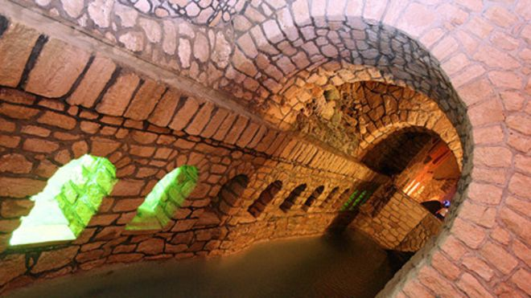
قنات‌ها در ایران
Notes:
http://www.bbc.com/persian/science/2015/12/151205_l10_nk_kariz_paris_cop21
7 ساعت پیش
هم‌رسانی
Image copyright MEHR Image caption بعضی قنات‌ها در ایران به «جاذبه‌های گردشگری» تبدیل شده‌اند از هزاران نفری که به پاریس رفته‌اند تا از تغییرات اقلیمی بگویند و بشنوند، هستند آب‌شناسانی که دل‌نگران از بین رفتن منابع آب شیرین در سرزمین‌های شوربخت هستند.
هزاران سال است که فلات ایران، میزبان میلیون‌ها ایرانی و غیر ایرانی بوده است. ایرانیان، دوره‌های ترسالی و خشک‌سالی بسیاری دیده‌اند و می‌دانند باید آنچه در ترسالی به کف آورده‌اند را در دوره‌های خشک‌سالی با مراقبت بیشتری مصرف کنند.
ایرانیان از هزاران سال پیش، آموخته بودند که آب را چگونه به کف آرند؛ می‌دانستند رسوبات درشت‌دانه‌ای که بین کوه و دشت قرار گرفته، آب در خود دارد و بسیاری از شهرها روی همین آبرفت‌ها بنا شد. آبرفت‌های درشت‌دانه، حاصل ارتفاع گرفتن و چین خوردگی و شکستگی و گسلش دائمی زمین و فرسایش طی هزاران یا میلیون‌ها سال بوده است. از رسوبات پایانی دوران سوم گرفته تا رسوبات دوران چهارم زمین‌شناسی.
ایرانیان باستان نیک می‌دانستند که می‌توان از دل همین آبرفت‌های درشت‌دانه، آب برای نوشیدن و کشاورزی فراهم کرد و راه‌های مدیریتش را هم یافته بودند. پدران ما، هزاران سال پیش از ظهور پادشاهان هخامنشی، کاریز را اختراع کردند. تمدن کاریزی حاصل همین فن‌آوری هوشمندانه و پایداری بود که از ایران به نقاط دوردست نیز کشیده شد.
بر پایه پژوهش‌های انجام گرفته در دهه ۴۰ شمسی، در ایران بیش از ۵۰ هزار رشته قنات به طول ۳۶۰ هزار کیلومتر ساخته شده و آب‌دهی این مجموعه در آن زمان، از ۵۰۰ متر مکعب در ثانیه فراتر می‌رفته است.
Image copyright MEHR اما ایرانیان دوران نوین، قدر دانسته پیشینیان خود را ندانستند. ندانستند که می‌توان با دانش روزگار نوین، قنات‌ها را گسترش داد و زنده کرد. برخی حتی فراموش کردند که جریان آب برخی قنات‌های ایران مرکزی، از جمله در میبد، آن‌قدر زیاد بوده که آسیاب آبی بر آن ساخته بودند.
از میان ایرانیان همه دوره‌ها، حاسب الکرجی را می‌توان مهم‌ترین دانشمند آب‌شناس ایران دانست. او بود که راه‌های کشف و استخراج آب‌های زیرزمینی را به روشی علمی تدوین کرد. کتاب «استخراج آب‌های پنهانی» کرجی که بیش از ۱۰۰۰ سال پیش نوشته شده، نه تنها برای کارشناسان آب که برای فیزیک‌دانان نیز خواندنی است. کرجی بود که پیش از بسیاری از دانشمندان اروپایی به کروی بودن زمین و نیروی جاذبه و قوانین حرکت و تعادل اشاره کرده بود.
کرجی در کتاب استخراج آب‌های پنهانی، توضیح می‌دهد که چگونه و از چه راه‌هایی می‌توان متوجه وجود آب در زیر زمین شد. او قواعد و قوانین حفر دهلیز و انتقال آب را هم شرح داده بود.
کرجی در اجلاس پاریس
اگر کرجی امروز زنده بود، چه می‌کرد؟ اگر به اجلاس پاریس می‌رفت، چه می‌گفت؟
بر پایه دانسته‌های امروزی، یک چهارم سطح کشورمان را رسوب فرا گرفته که متوسط عمق این آبرفت‌ها، کمتر از نیم کیلومتر است؛ برخی جاها بیشتر و در برخی کمتر. به عنوان مثال، عمق رسوبات در تهران در برخی نقاط به بیش از هزار متر می‌رسد. این حجم رسوبات دانه درشت می‌تواند بیش از ۵ هزار کیلومتر مکعب آب را در دل خود جا دهد، یعنی کمی بیش از ۱۲ برابر حجم بارش سالانه کشور در سال‌های پیشین (سالانه ۴۱۳ میلیارد متر کعب).
Image copyright TASNIM Image caption حفر چاه‌های عمیق باعث کاهش شدید آب‌های زیرزمینی در ایران شده است نزدیک به یک یازدهم مساحت کشور را رسوبات دانه درشت کوه‌پایه‌هایه‌ای و مخروط‌های افکنه در بر گرفته که اگر حاسب الکرجی امروز زنده بود، به عنوان آب‌شناس ارشد به حاکمان توصیه می‌کرد آب باران‌های سیل‌آسا و مخرب را تا حد ممکن در این رسوبات دانه درشت در مخروط‌های افکنه ذخیره کنند تا هم نسل‌های کنونی و هم نسل‌های بعدی، تشنه نمانند. راه چاره هم دشوار نیست...باید سرعت سیلاب را گرفت و با روش‌های ساده تغذیه مصنوعی، میزان جذب آب آبرفت‌ها را افزایش داد.
کرجی اگر امروز می‌زیست، حتماً به حاکمان می‌گفت که نباید اجازه حفر چاه‌های عمیق و استفاده از موتورپمپ‌های قدرتمند بهره‌مند از سوخت‌های فسیلی را بدهند.
البته اگر کرجی امروز زنده بود، باور نمی‌کرد که حاکمان در طی نیم قرن اخیر نسبت به حفر چاه‌های عمیق و مکیدن آخرین قطرات آب سفره‌های زیرزمینی، این همه بی‌تفاوت بوده‌اند. وقتی فضای خالی میان دانه‌های درشت و ریز زیر زمین از آب خالی شد، وزن طبقات بالایی، تدریجاً این فضا را از بین می‌برد و زمین، نشست می‌کند. امروزه صدها فروچاله در دشت‌های کشورمان، حاصل نشست زمین و مکیدن خون زمین هستند. دشت‌های پر آب، بی‌آب می‌شوند...دشت، بی‌آبان می‌شود...بیابان می‌شود.
اگر کرجی امروز زنده بود، می‌گفت که کاهش ذخیره برفی در مناطق کوهستانی، چقدر نگران کننده است و اگر می‌شنید که افزایش دمای زمین و فزونی گازهای گل‌خانه‌ای تا چه حد در کاهش بارش برف و ذخیره برفی کوه‌های چهار محال بختیاری و البرز مؤثر بوده، شاید سر به کوه و بیابان می‌گذاشت. کرجی اگر در اجلاس اقلیمی پاریس سخن رئیس سازمان حفاظت محیط زیست ایران را می‌شنید که قول داده در صورت برداشتن تحریم‌ها، ۴٪ تولید گازهای گلخانه‌ای ایران کاسته خواهد شد، از این حمه «سخاوت» می‌گریست!
Image copyright TASNIM Image caption آب ذخیره شده در دریاچه پشت سدها در معرض تبخیر شدید است کرجی اگر در پاریس بود، به جهانیان می‌گفت که ایران با همین باران کم شده‌اش که از متوسط ۲۵۰ میلیمتر در سال به ۱۹۷ میلیمتر رسیده، هنوز جای فراوانی برای ذخیره‌سازی آب و نگهبانی از ذخایر آب دارد. می‌گفت که ایرانیان کاریزساز می‌توانند از پس خشک‌سالی به خوبی بر آیند و نگرانی کمتری هم بابت افزایش میزان تبخیر سالانه که سهم قابل توجهی از آب پشت سدهای ساخته شده را تبخیر می‌کند، خواهند داشت. برای فرنگی‌ها توضیح می‌داد که با مهار سیلاب‌های پاییز و زمستان و بهار و تغذیه آبرفت‌های کوه‌پایه‌ها و بالا دست دشت‌ها، هم مانع فرسایش بخشی از خاک می‌تواند شد و هم آب ذخیره شده در زیر زمین، به اندازه آب دریاچه‌های دست‌ساز بشر، تبخیر نمی‌شود.
کرجی اگر به پاریس رفته بود، احتمالاً آمار واردات «آب مجازی» ایران را لو می‌داد و می‌گفت که کشورش به طور متوسط سالی ۹ کیلومتر مکعب «آب مجازی» وارد می‌کند. برای تولید بسیاری از محصولاتی که ایران وارد کرده، آب مصرف شده است. همچنین می‌گفت که چه بر سر هزاران تن سیب‌زمینی آمده که بعد از صرف میلیون‌ها متر مکعب آب برای کشت و تولید، ناگهان از بین رفته است.
کرجی اگر به پاریس رفته بود، می‌گفت که با مدیریت منطقی، نه تنها می‌توان مانع بیابانی شدن و گرمایش بیشتر ایران شد، که می‌توان با افزایش فضای سبز بر روی رسوبات دانه درشت، حتی در مقیاسی کوچک، تغییرات را وارونه کرد.
Image copyright TASNIM Image caption اگر برفی به کوهستان نبارد، به سالی دجله گردد خشک‌رودی کرجی اگر به پاریس رفته بود، حتماً هشدار می‌داد که ادامه روند فعلی نادیده گرفتن ذخایر ارزشمند آبرفتی، حتماً به مهاجرت میلیونی ایرانیان تا ۱۵ سال آینده منتهی خواهد شد. بسیاری از همین ایرانیان که بارش چند قطره باران را معادل رفع خشکسالی و بی‌آبی می‌دانند، اما یادشان رفته که اگر برفی به کوهستان نبارد، «به سالی دجله گردد خشک‌رودی».
کرجی اگر به پاریس رفته بود، به جماعت «جامعه مدنی» می‌گفت که راه و چاه انجام امور به‌دست مردمان را بیاموزند و منتظر دولت هم نمانند، که دولتیان تا متوجه عمق فاجعه بشوند، فلات ایران با بادهای خشک روی زمین‌های رطوبت از دست داده، بر باد خواهد رفت.
البته اگر کرجی امروز می‌زیست و این همه کولر آبی به جای بادگیر بر بام‌های تهرانی‌ها می‌دید، بر سر خود می‌کوبید و می‌گریست که چرا آب با ارزش رودخانه کرج را برای خنک کردن تهرانی‌ها هدر می‌دهند و بعد می‌گویند که تهرانی‌ها آب کافی برای نوشیدن نخواهند داشت…
هم‌رسانی چگونه می‌توانید این مطلب را به دیگران برسانید
ایمیل
Facebook
Twitter
Google+
Balatarin
بالا
مطالب مرتبط
صفحه ویژه: اجلاس تغییرات اقلیمی در پاریس
7 ساعت پیش
خشکسالی، خشکیدگی و بی‌آبی؛ وحشت بزرگ در کمین ایران
3 دسامبر 2015 - 12 آذر 1394
شش گرافیکی که تغییرات اقلیمی را توضیح می‌دهد
چ

